Slide 1


Fundamentals of RM
RM System and Process
Leadership in RM
Incident Investigation
RM Tools & Challenges
RM in Industry
People & Org.
Application and Perspectives
On Becoming a Leader
in Risk Management
ENGG404 - Lecture
Chapter 5.11: Prevention
Through Design

Slide 2
Learning Outcomes
Explain the concept of the life cycle of a system
Explain how to avoid hazard & risks through design
Explain the role of engineering (as designers) in the concept of Prevention Through Design (PTD)
Explain the overall the Design Safety Review Process
Describe how risk management tools are integrated within two key steps in DSR, specifically;
Step 3 – Design Safety Review Methods
Step 4 – Assess Design
Chapter 5.11: Prevention Through Design
2
Notes:
2

Slide 3
Introduction
Prevention Through Design:
An aspect of your risk management system to reduce losses by applying prevention through design principles early in design & redesign work.
Applies to ALL disciplines and fields of engineering
PTD tenets:
  Hazards & risks are most effectively & economically avoided, eliminated, or controlled during design & redesign (engineering).
  Hazard analysis is the most important safety process.
  Risk assessment is a cornerstone element of your management system.
  The purpose of those responsible for safety (regardless of formal titles) is to achieve an acceptable level of risk.
Why?
To address requirements in the design & redesign work processes to prevent or minimize hazards, risks, and prevent losses i.e. protect PEAP.
Create the design – the engineering control - to avoid the potential for human error.
Chapter 5.11: Prevention Through Design
3
Notes:
3

Slide 4
Why Engineers Need To Understand PTD
To reduce fatalities and serious incidents (FSIs), safety must be designed into facilities, systems, and work processes, methods – to avoid human error!
Avoidance and Elimination, the most effective risk treatment options, are only possible through design.
As Engineers, we have a key role in design, and as such need to know when in the life of a facility we have the most leverage in reducing risk to an acceptable level.
Some statistics:
U.S. studies indicate over 40% of construction fatalities connected to design aspect (Behm, 2005)
Australia Study of work-related fatalities (Safe Work Australia, 2014)
  12% caused by unsafe design-related factors
  24% were possibly caused by design-related factors
Chapter 5.11: Prevention Through Design
4
Notes:
4

Slide 5
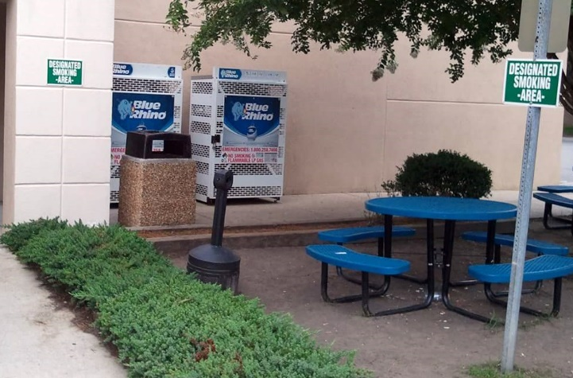
Embedded Hazards
If hazards are missed in design, they become embedded.
Why does that matter?
They permanently exist until removed by redesign.
They become the systemic underlying root cause for catastrophic incidents .
They also cause other problems related to operational performance including efficiency, quality & profitability.
Consider the scenario as depicted in the photo. “Blue Rhino” is a brand of pre-filled propane (LPG) BBQ tanks.
Inflammable vapours (LPG) and ignition sources should not be combined in uncontrolled areas!
Chapter 5.11: Prevention Through Design
5
Notes:
5

Slide 6
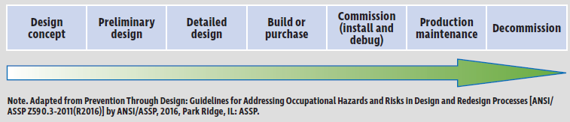
PTD Concept Over the Life Span of a System:
ANSI/ASSP Z590.3-2011 (R2016) – Prevention Through Design: Guidelines to Address Occupational Hazards and Risks in Design and Redesign Processes
Key aspect of this Standard is guidance for life-cycle risk assessment and a design model that balances EHS goals over the life span of a system
Systems such as facilities, equipment and products have a defined life cycle in which risks change
Chapter 5.11: Prevention Through Design
6
Notes:
6

Slide 7
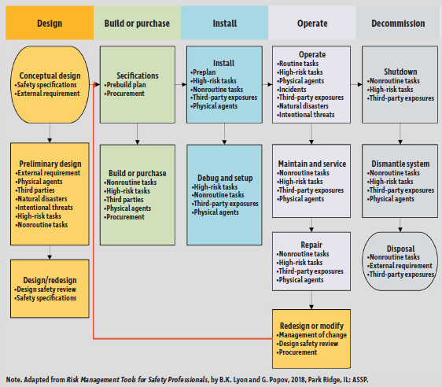
PTD During System Life Cycle
Chapter 5.11: Prevention Through Design
7
Notes:
7

Slide 8
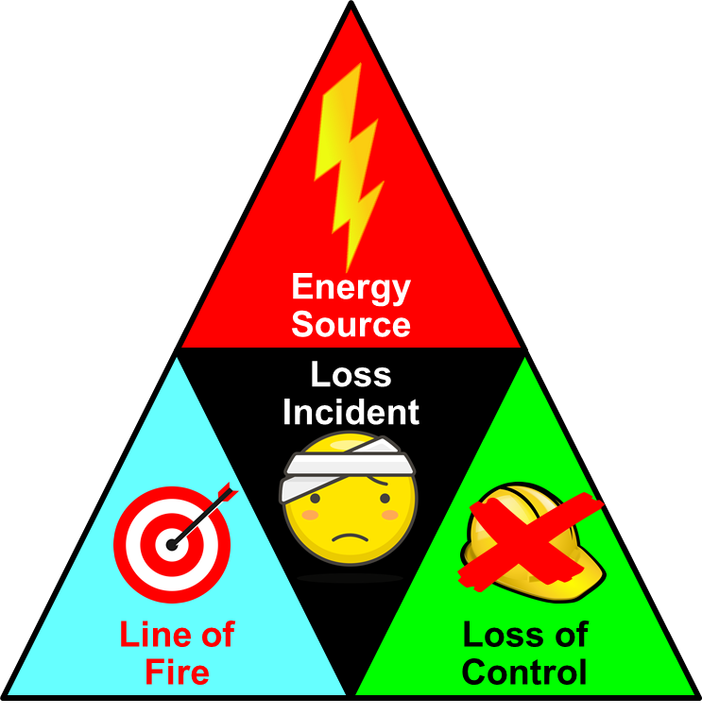
Haddon’s Model and Hazardous Energy Control:
A critical aspect in design is the control of hazardous energy
Haddon’s Model of energy release theory establishes a relationship between incident causation & risk control methods
Haddon’s Model can be applied systematically
Model includes 10 sequential control strategies that
should be considered in the design of new products
and system
  Prevent stored energy
  Reduce stored energy
  Prevent energy release
  Reduce rate of energy release
  Separate energy release from humans & assets by space or time
  Separate energy release from humans & assets by physical barriers
  Modify contact surfaces
  Strengthen susceptible structures
  Increase detectability and prevention of harm
  Prevent further damage
Chapter 5.11: Prevention Through Design
8
Notes:
8

Slide 9
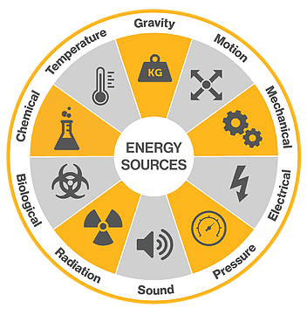
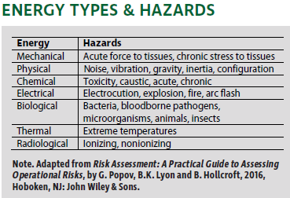
Haddon’s Strategies:
Strategy is derived from the model:
The most effective control is accomplished when it is incorporated into the design
Special attention is given to the potential for hidden energies in products and systems
A simple list of energy types and hazards should be considered during a design safety review
Chapter 5.11: Prevention Through Design
9
Notes:
9

Slide 10
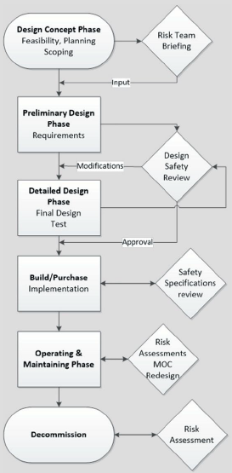
Design Safety Reviews (DSR) Work Process:
The purpose of a DSR is to avoid anticipated hazards in the design of a new system or redesign of an existing system
DSRs vary in their complexity, depending on the context & system under review
Methods include:
  Semi-Quantitative Analysis / SQRA
  What-If Analysis
  DSR Checklists & Guide Words
  Preliminary Process Hazard Analysis (PHA)
  Hazards & Operability Study (HAZOP)
  Failure Modes & Effects (FMEA) Analysis
DSR is most effective when performed early in in the design process while objectives are being discussed & during the MOC process
The life cycle of a system has several trigger points for a DSR
PTD!
Too late!
Chapter 5.11: Prevention Through Design
10
Notes:
10

Slide 11
ALE #1: What is Prevention Through Design?
Please confer and respond (MM-Poll):
Q: What is the significance of the difference
between the green-enveloped steps and the
red-enveloped steps?
Design activities in the green envelope go
through many iterations of reviews; whereas
the design activities within the red-envelope
are done only once.
The difference in steps denotes the half-way
point in the overall life-cycle of the
engineered system.
Design activities in the green envelop are
opportunities to most effectively eliminate or
avoid hazards; whereas design activities in
the red enveloped steps can only control the
hazards within the engineered system.
Chapter 5.11: Prevention Through Design
11
Notes:
11

Slide 12
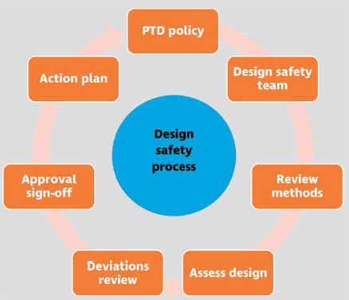
Overall Design Safety Review Work Process:
The DSR consists of 7 steps!
1
7
2
6
3
5
4
Chapter 5.11: Prevention Through Design
12
Notes:
12

Slide 13



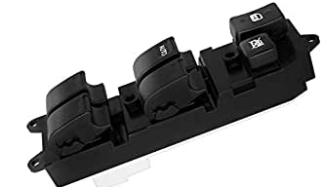
ALE #2: Prevention Through Design in Practice
Please confer and respond (MM-Poll):
Power windows: key operator hazard is
getting caught between the up-moving
window and the door frame
Q: Consider these two different
power-window switch assemblies.
Which one underwent PTD?
A
B
NO DIFFERENCE
A
B
Chapter 5.11: Prevention Through Design
13
Notes:
13

Slide 14
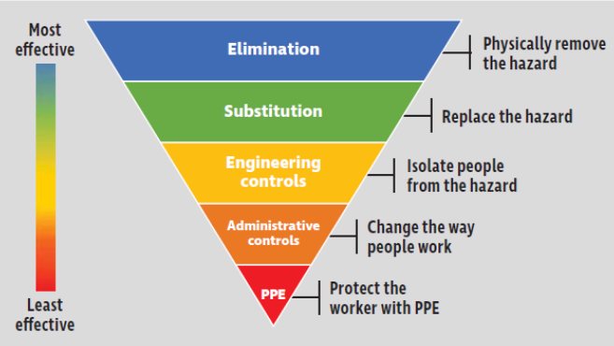
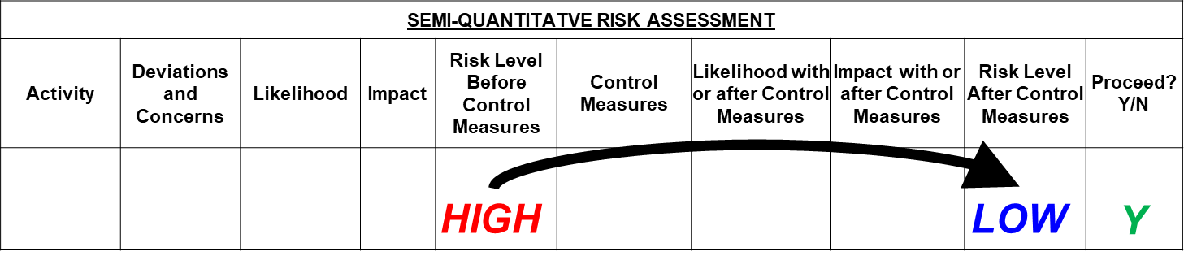
Summary and Key Lessons:
PTD reduces losses by applying prevention through design principles early in design & redesign work, when hazards & risks are most effectively & economically avoided.
  Two key tenets of PTD:
  Hazard analysis is the most important safety process.
  Risk assessment is a cornerstone element of your management system.
PTD includes identifying & evaluating hazards, & proposing measures to reduce associated risks to an acceptable level.
Apply the Incident Model and the Energy Wheel
within Haddon’s Strategies for
Hazardous Energy Control
Integrate risk assessment methods and hierarchy of risk reduction within
design safety review work processes
Chapter 5.11: Prevention Through Design
14
Notes:
14

Slide 15
Any questions?
Notes:
15

